Slide 1
THANK YOU
Board, NANOG Committees, Sponsors, Members and NANOG 59 Attendees
Thank you to NANOG Staff

Slide 2
Agenda
Financial Report
(Duane - Treasurer)
5Y Strategic Plan
(Sylvie – Chair, Mike – Vice-Chair)

Slide 3
Financial Report Duane Wessels
Looking Back
Looking Ahead
2012 Audit approved
2013 Statements in ARO (to August)
$500k reserve invested in laddered CDs
Increased staff spending
Drafting 2014 Budget
New Programs
Education
On The Road
BCOP

Slide 4
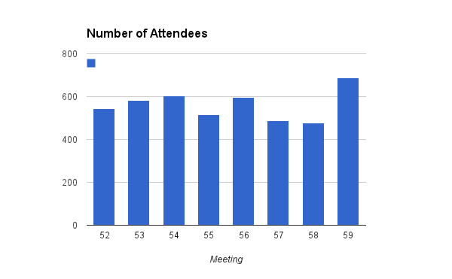

Slide 5
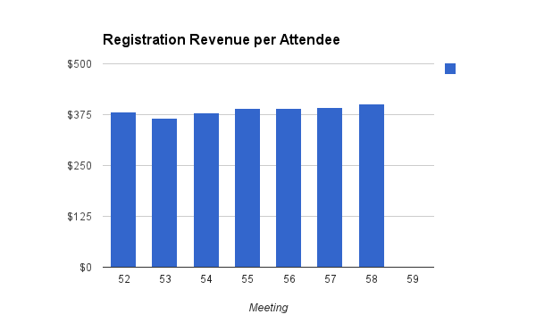

Slide 6
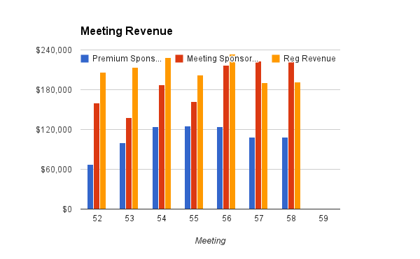

Slide 7
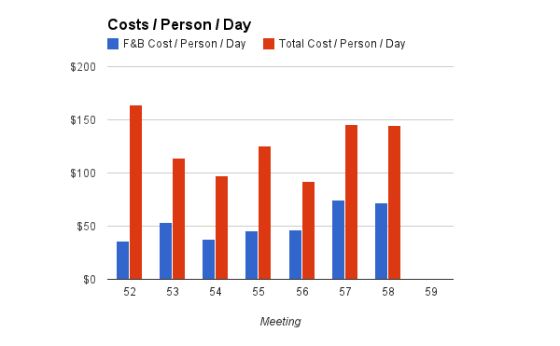

Slide 8
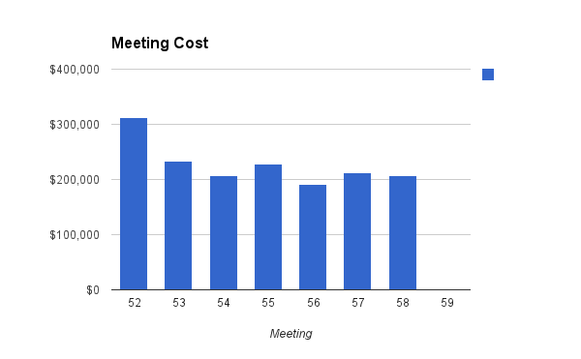

Slide 9
3Y Strategic Plan 2010-2013 Sylvie LaPerrière, Chair

Slide 10
Performance on 3-Year Game Plan
TRANSITION
NANOG 52-53-54
CONSTRUCTION
NANOG 55-56-57
CONSOLIDATION
NANOG 58-59-60
Financial sustainability
Continued operations ‘don’t’ break it’
Contract staff and systems
Communications to community
Financial health to payback start loan
Membership engagement
Program Reformat
Elections (56), committees-bylaws
Communications to community
Have $250k reserve
Membership engagement - early and mid career
Education program
Website redesign launch
Communications to community
✔
✔
✔
✔
✔
✔
✔
✔
✔
✔
✔
✔

Slide 11
5Y Strategic Plan 2013-2017 Sylvie LaPerrière, Chair Mike K. Smith, Vice-Chair

Slide 12
NANOG 5Y Strategy (Dec 2012)
Full-day offsite, no phone no laptop
Focus on 3 goals:
Provide a framework for North American Operators’ input into Internet operations (Sylvie)
Create industry-recognized education and publication programs (Steve G)
Create compelling value proposition for the operator community (Dave T)

Slide 13
5-Year Game Plan: 3 Goals
Provide a framework for N. A. Operators’ input into Internet operations
Create Industry-recognized education programs and publications
Create compelling value proposition for the community
2
0
1
3
Shift balance of effort to shape as well as educate
Build BCOP with alliances outside NA
Plan and Support
Define peer orgs and establish relations with Ops orgs outside NA
Explore strategic options w/ ARIN
Include regulatory material in program and assess
Plan long-term university relationships
Edu Series: Build portfolio for full career range
1ST class at N59
Define the publication strategy and identfy venues
Articulate value prop for members, sponsors
Productized Sponsorship pkgs
Sponsors policy & procedures
Sponsors’ customer service
Target early career
1st NoTR
✔
✔
✔
✔
✔
✔
✔
✔
✔
✔
✔
✔
✔
✔
✔
✔

Slide 14
5-Year Game Plan: 3 Goals
Provide a framework for N. A. Operators’ input into Internet operations
Create Industry-recognized education programs and publications
Create compelling value proposition for the community
2
0
1
4
Shift balance of effort to shape as well as educate
Present fact findings from stakeholders outreach mission at N60
BCOP: build alliance with intl peer orgs
Support BCOP Plan
Universities: establish strong relationships w/higher education
Edu Series:
Coop program
Tech classes
Publication Strategy: editor, secure content, publish
Articulate and plan value prop for members
Discuss number of large NANOG meetings, NoTR and assess venue requirements

Slide 15
5-Year Game Plan: 3 Goals
Provide a framework for N. A. Operators’ input into Internet operations
Create Industry-recognized education programs and publications
Create compelling value proposition for the community
2
0
1
5
NANOG is the focal venue for forces shaping the Internet
Integrate stakeholders orgs into program tracks
More integrate relationship between ARIN and NANOG
Assess/ strengthen gvt outreach for Internet operational standards
Stronger relationships with higher education
Regional Edu events for career development needs
Initial publications including BCOP materials
Regional NANOG events continue to draw wider range of attendees with specific focus on early&mid career professionals
✔

Slide 16
5-Year Game Plan: 3 Goals
Provide a framework for N. A. Operators’ input into Internet operations
Create Industry-recognized education programs and publications
Create compelling value proposition for the community
2
0
1
7
Expand conference content to include the forces that shape the Internet with Plenaries and tracks
Expand relations with ops orgs outside NA
Operating under long-term structure
Active role in gvt outreach for members interest with identified activities/staff
Industry-wide recognition for formal education
Certification track for early and mid-career engineers
Industry-wide recognition for NANOG publications
Local conferences in major markets provide exceptional networking and targeted education
✔

Slide 17
Chair Observations
3Y strategic plan - key to stay course 2010-13
Clear direction
Eases onboarding of new Directors every year
Clarity and accountability to membership
Audacious 5Y strategic plan: BIG goals
Culture : Try new , Fail, Try again

Slide 18
Closing Remarks
Community governance and focus
Volunteer to serve on Board and Committees
Please complete the NANOG 59 Survey

Slide 19
